Slide 1

Final Project
3D recovery of Urban Scenes
Team 7
Sergio Castro, Sergio Sancho & Axel Barroso
M6: 3D Vision
Masters in Computer Vision
Universitat Autònoma
de Barcelona

Slide 2
Summary
Project Overview
Workflow
Part I: Image transformation
Part II: Compute the homography that relates to images
Part III: Compute the fundamental matrix that relates two images
Part IV: Reconstruction from two images
Part V: Reconstruction from uncalibrated images with a stratified method
Results and Conclusions

Slide 3
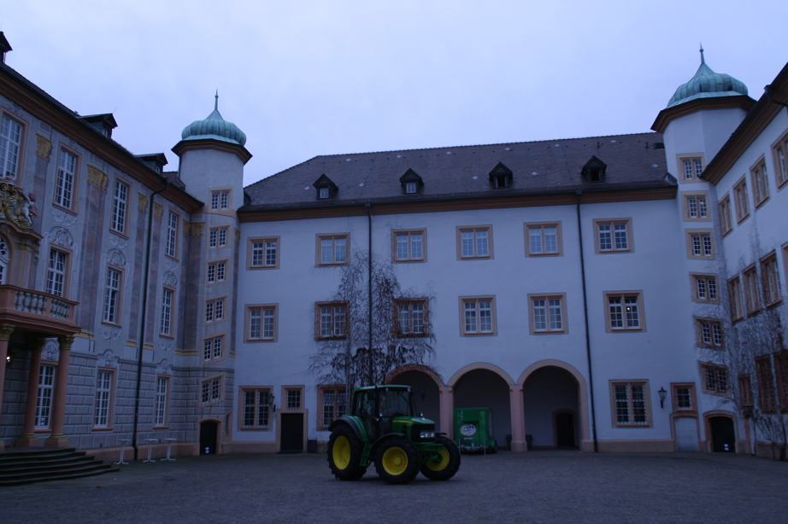
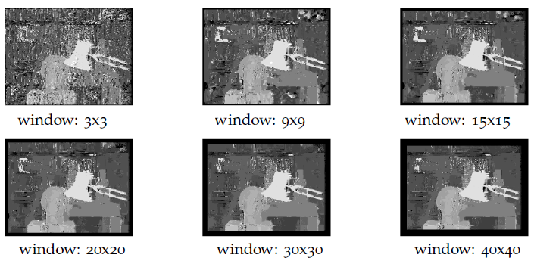
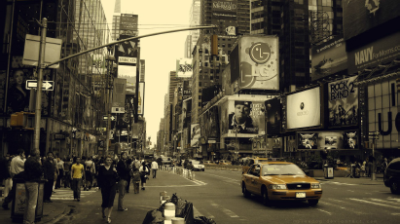
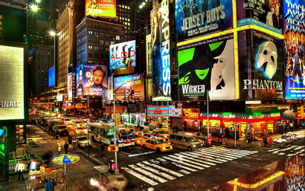
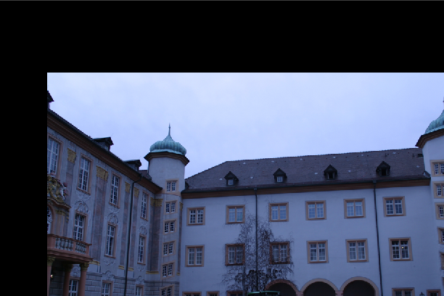
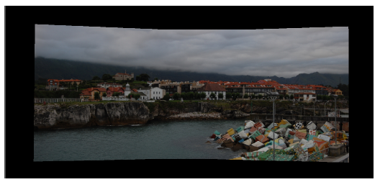
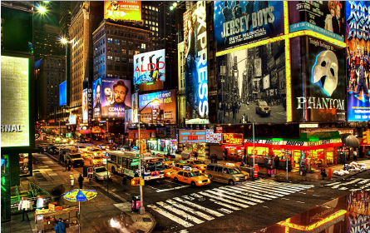
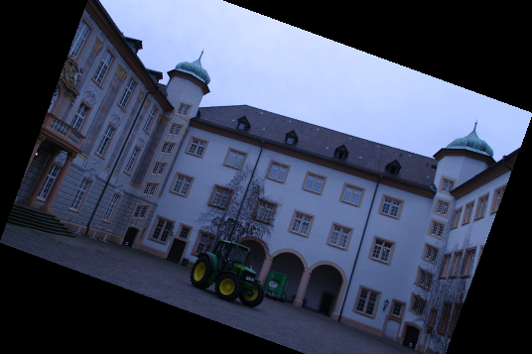
Project Overview
A big number of applications can be developed by using basic 3D techniques and approaches.

Slide 4
Part I: Image transformations
Image transformations: Overview

Slide 5
Part I: Image transformations
Image transformations: Overview

Slide 6

Part I: Image transformations
Image transformations: Overview

Slide 7
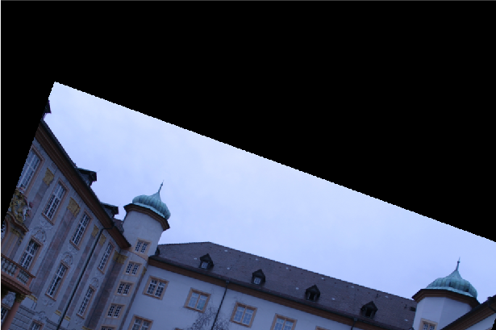
Part I: Image transformations
Image transformations: Overview

Slide 8
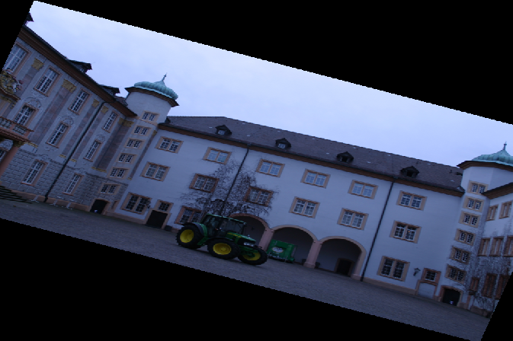
Part I: Image transformations
Image transformations: Overview

Slide 9
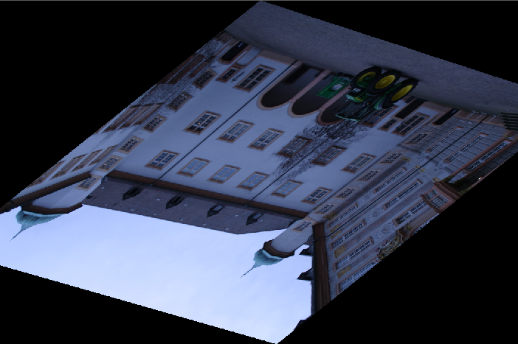
Part I: Image transformations
Image transformations: Overview

Slide 10
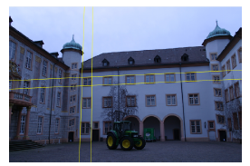
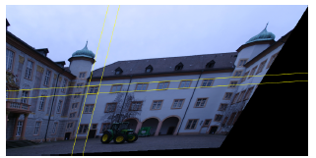
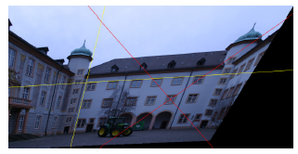
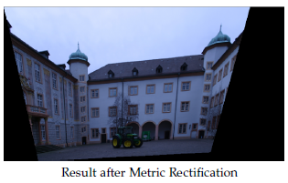
Part I: Image transformations
Affine and metric transformation
Erase the perspective view.
Two-step algorithm.
Delete the projective distortions of the image by applying affine rectification.
Recover the metric properties lost in the affine rectification by applying metric rectification.

Slide 11
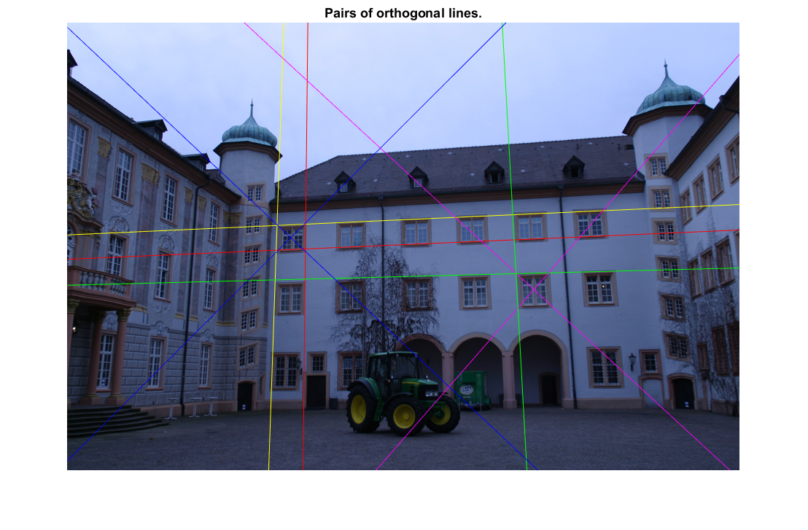
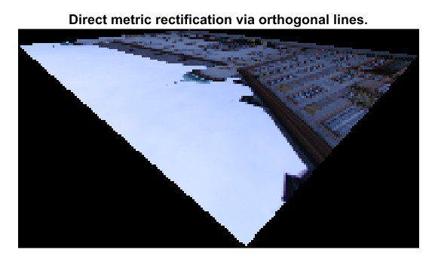
Part I: Image transformations
Metric rectification from original image
Compute metric rectification from original perspective image of the plane. By using 5 pairs of orthogonal lines we are able to compute the conic matrix, which determines the circular points, and equivalently the projective transformation necessary to metrically rectified the image. And then, we easily get H.
The problem comes when we select pairs of lines that are parallel between them.

Slide 12
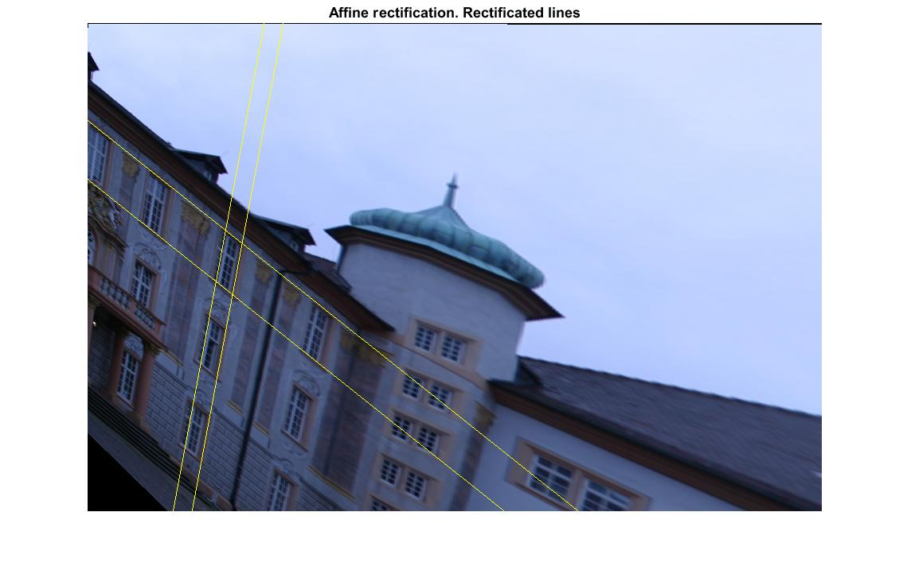
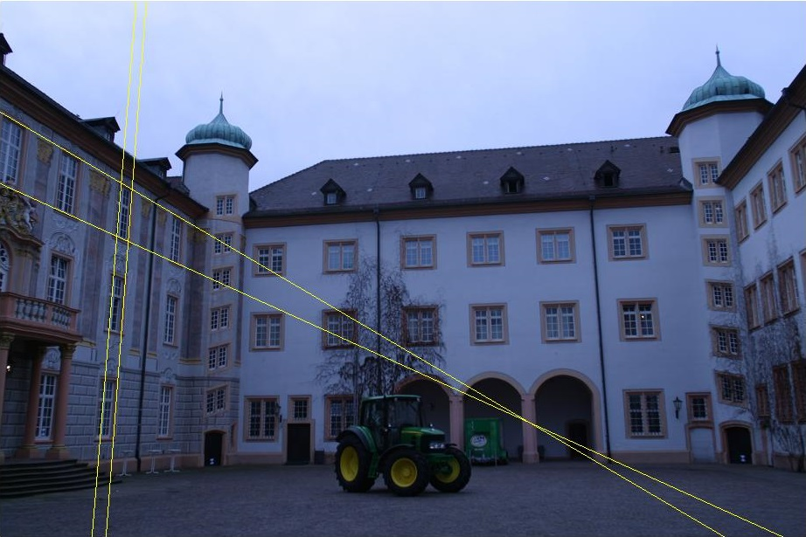
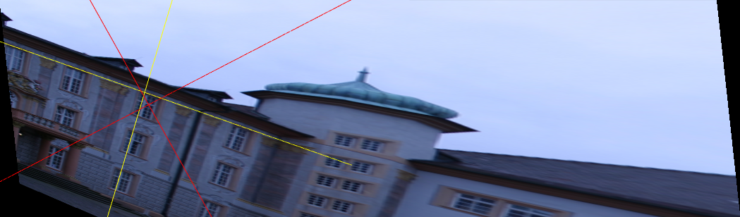
Part I: Image transformations
Affine and metric rectification of additional facades

Slide 13
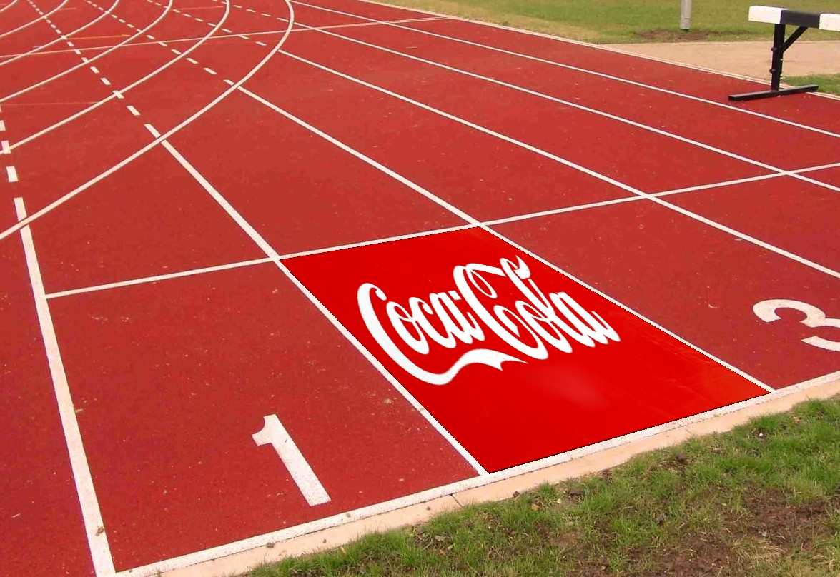
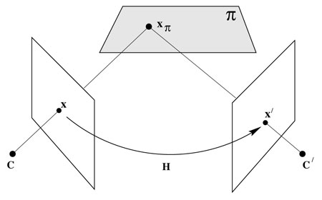
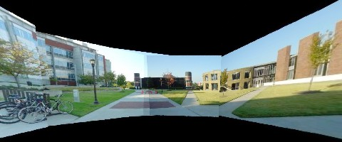
Part II: Compute the homography that relates to images
Homography
Homography allows us to relate images that are:
In the same plane in a 3D scene
Taken with a camera rotating about its center
Taken with the same static camera varying the focal length
Far away from the camera
Notes:
Homography allows us to relate two images (or more) that are:
In the same plane in a 3D scene
Taken with a camera rotating about its center
Taken with the same static camera varying the focal length
Far away from the camera

Slide 14
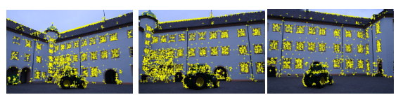
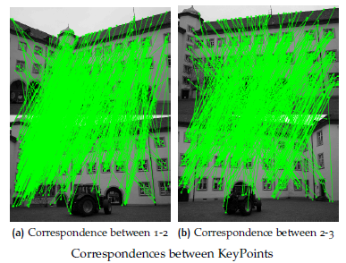
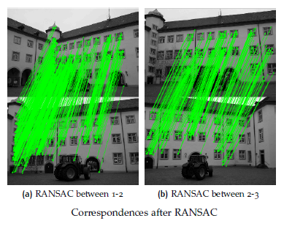
Part II: Compute the homography that relates to images
Algorithm for a robust computation of the 2D homography between two images
Interest points
Putative correspondences
RANSAC robust estimation
Select a random sample of 4 correspondences and compute the fundamental matrix H using the normalized DLT algorithm.
Compute inliers
Repeat
Re-estimation
SIFT key points
Notes:
DLT normalized beacuse It is not invariant to similarity transformations of the image.
Thus some coordinate systems are in some way better than others for
computing a 2D homography.

Slide 15
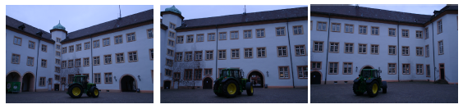
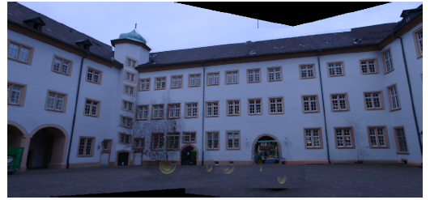
Part II: Compute the homography that relates to images
Mosaic
Different centers between images
Images too close
Poor keypoint correspondences (Gold-Standard Algorithm)
Notes:
Gold-Standard Algorithm. Reduces Reproduction Error Between Keypoints

Slide 16
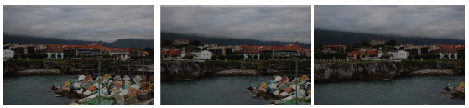
Part II: Compute the homography that relates to images
Mosaic
Different centers between images
Images too close
Poor keypoint correspondences (Gold-Standard Algorithm)

Slide 17
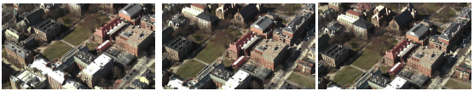
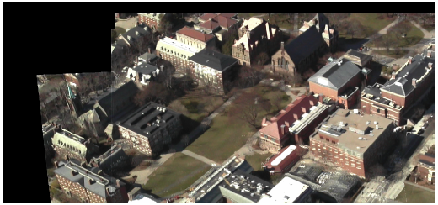
Part II: Compute the homography that relates to images
Mosaic
Different centers between images
Images too close
Poor keypoint correspondences (Gold-Standard Algorithm)

Slide 18
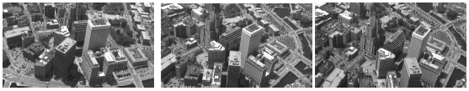
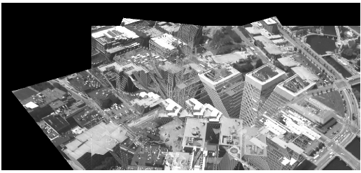
Part II: Compute the homography that relates to images
Homography - DLT Algorithm, Mosaic
Different centers between images
Images too close
Poor keypoint correspondences (Gold-Standard Algorithm)

Slide 19
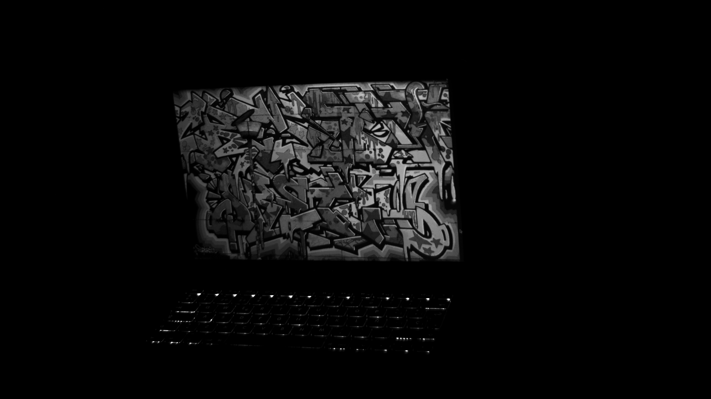
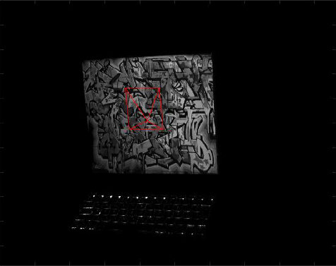
Part II: Compute the homography that relates to images
More applications

Slide 20
Part III: Compute the fundamental matrix that relates two images
Fundamental Matrix, Theory

Slide 21
Part III: Compute the fundamental matrix that relates two images
Fundamental Matrix, Theory
Solve system of equations
8 different Unknowns
Minimization Problem

Slide 22
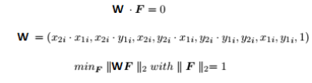
Part III: Compute the fundamental matrix that relates two images
Fundamental Matrix, Theory
Solve system of equations
8 different Unknowns
Minimization Problem

Slide 23
Part III: Compute the fundamental matrix that relates two images
Fundamental Matrix, Theory
Solve system of equations
8 different Unknowns
Minimization Problem
Denormalize F with SVD

Slide 24
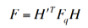
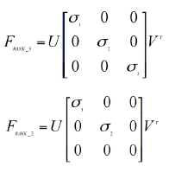
Part III: Compute the fundamental matrix that relates two images
Fundamental Matrix, Theory
Solve system of equations
8 different Unknowns
Minimization Problem
Denormalize F with SVD

Slide 25
Part III: Compute the fundamental matrix that relates two images
Fundamental Matrix, Applications
We can find epipolar lines between related images

Slide 26
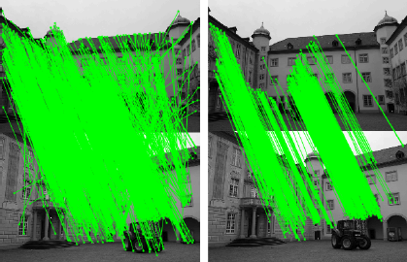
Part III: Compute the fundamental matrix that relates two images
Fundamental Matrix, Applications
We can find epipolar lines between related images
Find the Keypoints
Apply Ransac

Slide 27
Part III: Compute the fundamental matrix that relates two images
Fundamental Matrix, Applications
We can find epipolar lines between related images
Find the Keypoints
Apply Ransac
Compute 8th point Algorithm
Choose 3 random points to compute the epipolar lines

Slide 28
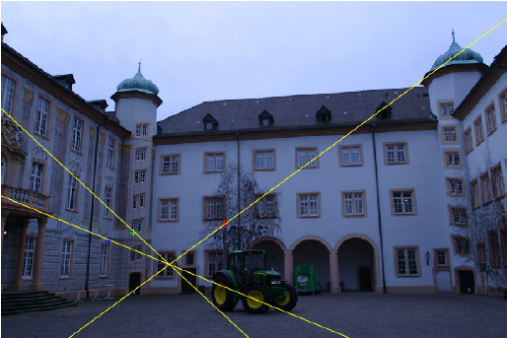
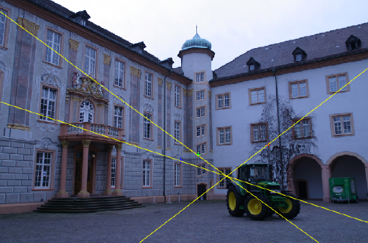
Part III: Compute the fundamental matrix that relates two images
Fundamental Matrix, Applications
We can find the same point between related images
Find the Keypoints
Apply Ransac
Compute 8th point Algorithm
Choose 3 random points to compute the epipolar lines

Slide 29
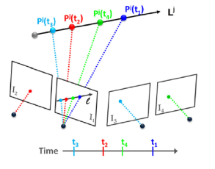
Part III: Compute the fundamental matrix that relates two images
Fundamental Matrix, Photo Sequencing
Order temporally a set of images
Pick manually a point in the reference image
Compute the fundamental matrix between the images and the reference
The intersection between the different epipolar lines gives the time-order

Slide 30
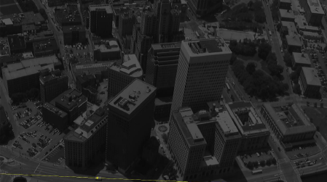
Part III: Compute the fundamental matrix that relates two images
Fundamental Matrix, Photo Sequencing
Order temporally a set of images
Pick manually a point in the reference image
Compute the fundamental matrix between the images and the reference
The intersection between the different epipolar lines gives the time-order

Slide 31
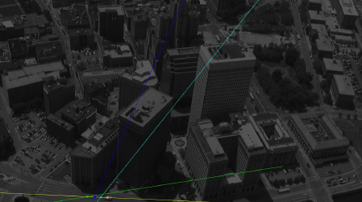
Part III: Compute the fundamental matrix that relates two images
Fundamental Matrix, Photo Sequencing
Order temporally a set of images
Pick manually a point in the reference image
Compute the fundamental matrix between the images and the reference
The intersection between the different epipolar lines gives the time-order

Slide 32
Part IV: Reconstruction from two images
Reconstruction
Triangulation Method

Slide 33
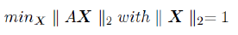
Part IV: Reconstruction from two images
Reconstruction
Triangulation Method
Different cameras with known Projection Matrices
Apply DLT Algorithm

Slide 34
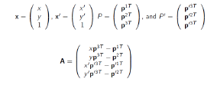
Part IV: Reconstruction from two images
Reconstruction
Triangulation Method
Different cameras with known Projection Matrices
Apply DLT Algorithm
Find A multiplying →

Slide 35
Part IV: Reconstruction from two images
Reconstruction, Applications
Apply SIFT and Ransac to the images
Compute the Essential Matrix with the SVD

Slide 36
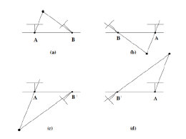
Part IV: Reconstruction from two images
Reconstruction, Applications
Apply SIFT and Ransac to the images
Compute the Essential Matrix with the SVD

Slide 37
Part IV: Reconstruction from two images
Reconstruction, Applications
Apply SIFT and Ransac to the images
Compute the Essential Matrix with the SVD
Choose the correct view

Slide 38
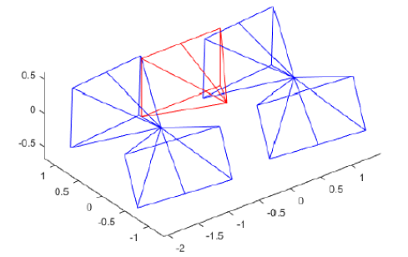
Part IV: Reconstruction from two images
Reconstruction, Applications
Apply SIFT and Ransac to the images
Compute the Essential Matrix with the SVD
Choose the correct view

Slide 39
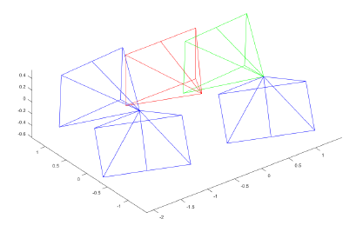
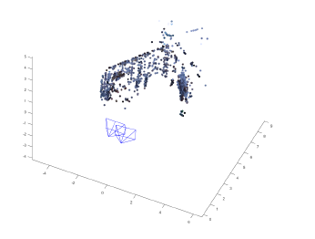
Part IV: Reconstruction from two images
Reconstruction, Applications
Apply SIFT and Ransac to the images
Compute the Essential Matrix with the SVD
Choose the correct view

Slide 40

Part IV: Reconstruction from two images
Reconstruction, Depth Computation
Find the Correspondences between points belonging to the same location
The disparities allows us to calculate the Depth
SSD cost
NCC cost
Bilateral Weights

Slide 41
Part IV: Reconstruction from two images
Reconstruction, Depth Computation
SSD cost → Minimize Sum of Squares Difference

Slide 42

Part IV: Reconstruction from two images
Reconstruction, Depth Computation
SSD cost → Minimize Sum of Squares Difference

Slide 43
Part IV: Reconstruction from two images
Reconstruction, Depth Computation
SSD cost → Minimize Sum of Squares Difference
Results are window Dependent
Bigger window→ Blur Objects, No noise
Small window → More precise, Noise

Slide 44


Part IV: Reconstruction from two images
Reconstruction, Depth Computation
Bigger window→ Blur Objects, No noise
Small window → More precise, Noise

Slide 45
Part IV: Reconstruction from two images
Reconstruction, Depth Computation
NCC cost → Maximize Correlation

Slide 46

Part IV: Reconstruction from two images
Reconstruction, Depth Computation
NCC cost → Maximize Correlation

Slide 47
Part IV: Reconstruction from two images
Reconstruction, Depth Computation
NCC cost → Maximize Correlation
Higher Computation Times
Slightly lower Performance than SSD

Slide 48

Part IV: Reconstruction from two images
Reconstruction, Depth Computation
Higher Computation Times
Slightly lower Performance than SSD

Slide 49
Part IV: Reconstruction from two images:
Reconstruction, Depth Computation
Bilateral W. → Minimize the cost by using weights
based on color similarity and distance

Slide 50

Part IV: Reconstruction from two images
Reconstruction, Depth Computation
Bilateral W. → Minimize the cost by using weights
based on color similarity and distance

Slide 51
Part IV: Reconstruction from two images
Reconstruction, Depth Computation
Bilateral W. → Minimize the cost by using weights
based on color similarity and distance
Similar Performance to NCC
Better Result with 30x30 window

Slide 52
Part IV: Reconstruction from two images
Reconstruction, Depth Computation
Similar Performance to NCC
Better Result with 30x30 window

Slide 53


Part IV: Reconstruction from two images
Reconstruction, Depth Computation with Façades
Façade Images:

Slide 54
Part IV: Reconstruction from two images
Reconstruction, Depth Computation with Façades
Façade Images:

Slide 55

Part IV: Reconstruction from two images
Reconstruction, Depth Computation with Façades
Façade Images:
SSD Cost → 40*40 window

Slide 56

Part IV: Reconstruction from two images
Reconstruction, Depth Computation with Façades
Façade Images:
NCC Cost → 20*20 window

Slide 57

Part IV: Reconstruction from two images
Reconstruction, Depth Computation with Façades
Façade Images:
Bilateral → 40*40 window

Slide 58
Part IV: Reconstruction from two images
Reconstruction, Depth Computation with Façades
Façade Images:
SSD Cost → 40*40 window
NCC Cost → 20*20 window
Bilateral → 40*40 window

Slide 59
Part IV: Reconstruction from two images
Reconstruction, Depth Computation with Façades
Façade Images:
SSD Cost → 40*40 window
NCC Cost → 20*20 window
Bilateral → 40*40 window

Slide 60
Part IV: Reconstruction from two images
Reconstruction, Depth Computation with Façades
Façade Images:
SSD Cost → 40*40 window
NCC Cost → 20*20 window
Bilateral → 40*40 window
Best Performance!!!

Slide 61



Part V: Reconstruction from uncalibrated images with a stratified method
Reconstruction, Overview (using synthetic data)
Goal: compute 3D reconstruction from two or more camera views
Projective reconstruction
Affine reconstruction
Metric reconstruction
Given the 2D coordinates of points in each image, compute the 3D points and projective matrices correspondent to both views
Construct the affine homography to recover properties such as parallelism between lines
Compute the metric reconstruction to recover metric properties such as the real angles of the scene

Slide 62



Part V: Reconstruction from uncalibrated images with a stratified method
Reconstruction, Projective reconstruction
Projective reconstruction
Procedure:
Obtain the points of the image using sift and RANSAC.
Get the inliers and using them as the points of the image to reconstruct.
Compute the factorization method of Sturm and Triggs 1996.
We have tried two lambda initializations:
worked best!

Slide 63

Part V: Reconstruction from uncalibrated images with a stratified method
Reconstruction, Affine reconstruction
Affine reconstruction
Affine homography is composed by: identity matrix and the line at infinity in the last row.
For computing the line at infinity we only need three vanishing points in 3D.
These are obtained by triangulating the three vanishing points in 2D for every image.
Then the line at infinity is the null vector of the matrix.

Slide 64

Part V: Reconstruction from uncalibrated images with a stratified method
Reconstruction, Metric reconstruction
Metric reconstruction
Compute the three vanishing points (u,v,z) of one image using the following constraints:
this gives us the rules to build A matrix
we can build ω by computing the null space of it
finally, we can build the homography using a Cholesky decomposition

Slide 65

Part V: Reconstruction from uncalibrated images with a stratified method
Reconstruction, Real data I

Slide 66



Part V: Reconstruction from uncalibrated images with a stratified method
Reconstruction, Real data II
Projective reconstruction
Affine reconstruction
Metric reconstruction

Slide 67
Conclusions
Image transformations and rectifications to recover scene properties.
Fundamental matrix is a key concept.
Estimate depth.
Mosaics and order scenes in time.
Reconstruct a real world scene given several points of view of it.
Almost every part of the project can be directly applied to pics captured using our own smartphones.
Visual results.

Slide 68
Final Project
3D recovery of Urban Scenes
Team 7
Sergio Castro, Sergio Sancho & Axel Barroso
M6: 3D Vision
Masters in Computer Vision
Universitat Autònoma
de Barcelona

